Slide 1
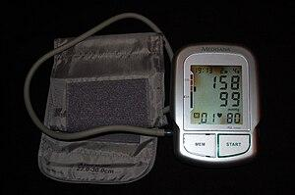
Hypertension
Hypertension
  Also known as high blood pressure
Major cause of premature death worldwide
Rarely accompanied by symptoms
Classified by two measurements:
  Systolic
    Maximum Pressure
  Diastolic
    Minimum Pressure

Slide 2

Hypertensive crisis
Severely elevated blood pressure
  Equal to or greater than a systolic 180 or diastolic 120
Two categorizations:
  Hypertensive Urgency
    No evidence of organ damage
  Hypertensive Emergency
    Direct damage to one or more organs
    Most affected organs are brain, kidney, heart and lungs
    SX: Confusion, drowsiness, chest pain and breathlessness

Slide 3
Hypertension in Kidney Disease
Hypertension is commonly found in both acute and chronic kidney disease
The pathogenesis of hypertension varies with the type of disease (eg, glomerular versus vascular) and with the duration of disease (acute versus chronic)
Acute glomerular disease — Patients with acute glomerular disease are typically volume expanded due to sodium retention. As a result, the elevation in blood pressure in patients with acute glomerular disease is primarily due to fluid overload
Experimental studies suggest that sodium retention in kidney disease is due to increased reabsorption in the collecting tubules

